Slide 1
MATLAB for Engineering Applications Fifth Edition
William J. Palm III
© McGraw Hill LLC. All rights reserved. No reproduction or distribution without the prior written consent of McGraw Hill LLC.

Slide 2
Chapter 01
An Overview of MATLAB

Slide 3
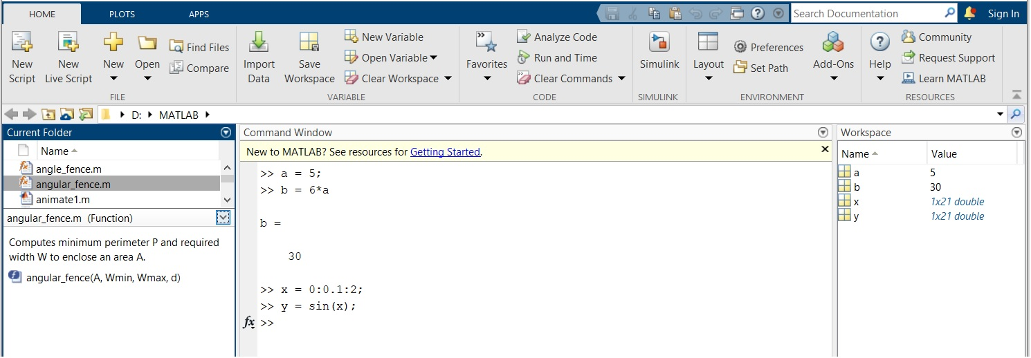
The Default MATLAB Desktop
Access the text alternative for slide images.
Source: MATLAB

Slide 4
Entering Commands and Expressions
MATLAB retains your previous keystrokes.
Use the up-arrow key to scroll back through the commands.
Press the key once to see the previous entry, and so on.
Use the down-arrow key to scroll forward. Edit a line using the left- and right-arrow keys the Backspace key, and the Delete key.
Press the Enter key to execute the command.

Slide 5
Scalar Arithmetic Operations

Slide 6
An Example Session
>> 8/10
ans =
0.8000
>> 5*ans
ans =
4
>> r=8/10
r =
0.8000
>> r
r =
0.8000
>> s=20*r
s =
16

Slide 7
Order of Precedence
Precedence | Operation
First | Parentheses, evaluated starting with the innermost pair.
Second | Exponentiation, evaluated from left to right.
Third | Multiplication and division with equal precedence, evaluated from left to right.
Fourth | Addition and subtraction with equal precedence, evaluated from left to right.

Slide 8
Examples of Precedence 1
>> 8 + 3*5
ans =
23
>> 8 + (3*5)
ans =
23
>>(8 + 3)*5
ans =
55
>>4^2­12­8/4*2
ans =
0
>> 4^2­12­ 8/(4*2)
ans =
3

Slide 9
Examples of Precedence 2
>> 3*4^2 + 5
ans =
53
>>(3*4)^2 + 5
ans =
149
>> 27^(1/3) + 32^(0.2)
ans =
5
>>27^(1/3) + 32^0.2
ans =
5
>> 27^1/3 + 32^0.2
ans =
11

Slide 10
Commands for Managing the Work Session 1
clc | Clears the Command window.
clear | Removes all variables from memory.
clear x y | Removes the variables x and y from memory.
exist(‘abc’) | Determines if a file or variable exists having the name ‘abc’.
quit | Stops MATLAB.

Slide 11

Commands for Managing the Work Session 2
who | Lists the variables currently in memory.
whos | Lists the current variables and sizes and indicate if they have imaginary parts.
colon | Colon; generates an array having regularly spaced elements.
comma | Comma; separates elements of an array.
semicolon | Semicolon; suppresses screen printing; also denotes a new row in an array.
ellipsis | Ellipsis; continues a line.

Slide 12
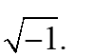
Special Variables and Constants
ans | Temporary variable containing the most recent answer.
eps | Specifies the accuracy of floating-point precision.
i, j | The imaginary unit the square root of negative 1
Inf | Infinity.
NaN | Indicates an undefined numerical result.
pi | The number π.

Slide 13
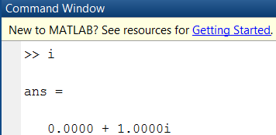
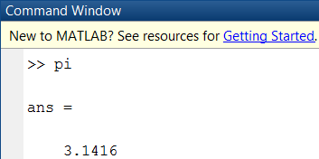
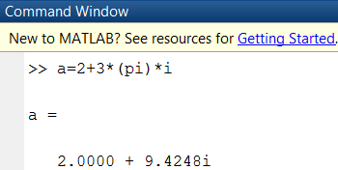

Slide 14
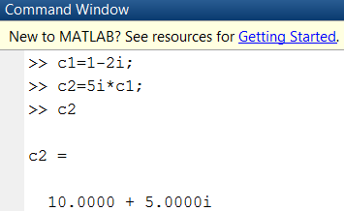
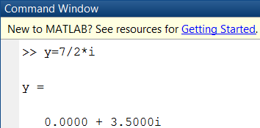
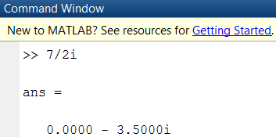
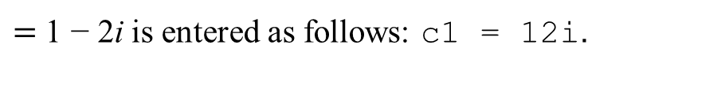
Complex Number Operations
The number
$=$ 1 − 2i is entered as follows: c1 = 1­2i.
An asterisk is not needed between i or j and a number, although it is required with a variable, such as c2 = 5i*c1.
Be careful. The expressions
y = 7/2*i
and
x = 7/2i
give two different results:
y = (7/2)i = 3.5i
and
x = 7/(2i) = −3.5i.

Slide 15
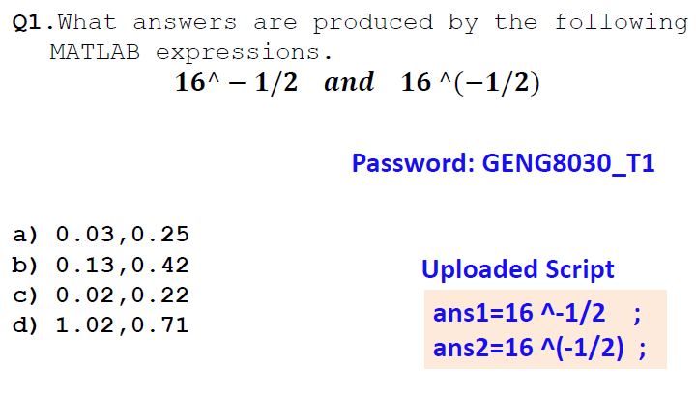
15

Slide 16
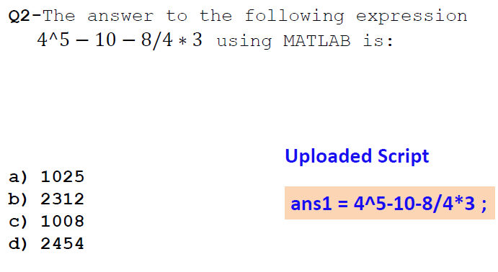

Slide 17
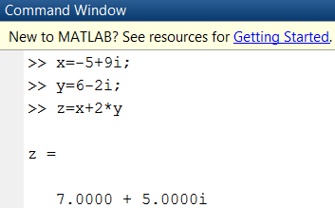
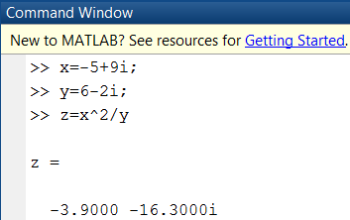
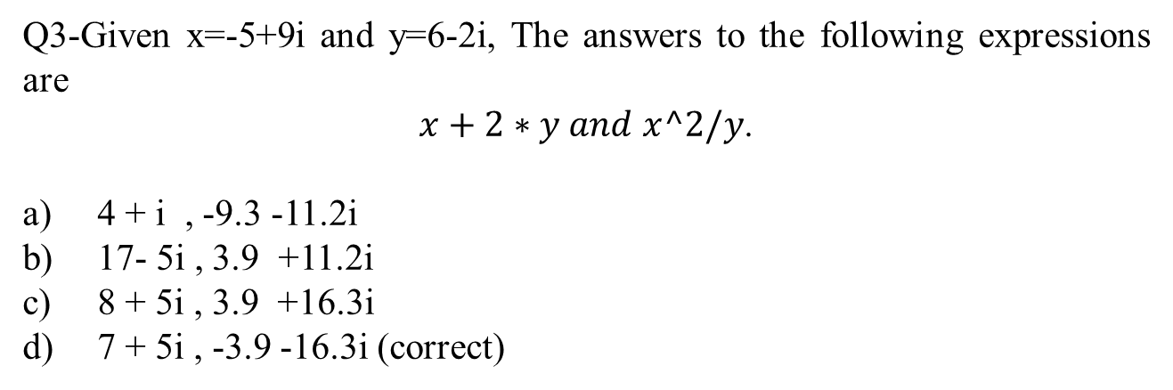
Q3-Given x=-5+9i and y=6-2i, The answers to the following expressions are
$x+2∗y and$ $x^2/y$.
4 + i , -9.3 -11.2i
17- 5i , 3.9 +11.2i
8 + 5i , 3.9 +16.3i
7 + 5i , -3.9 -16.3i (correct)

Slide 18
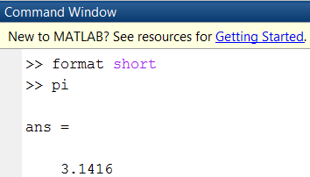
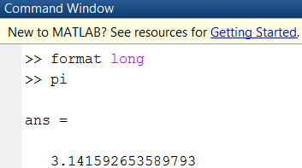
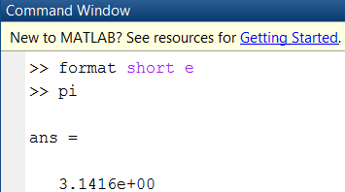
Numeric Display Formats 1
format short | Four decimal digits (the default); 13.6745.
format long | 16 digits; 17.27484029463547.
format short e | Five digits (four decimals) plus exponent; 6.3792e+03.
format long e | 16 digits (15 decimals) plus exponent; 6.379243784781294e−04.

Slide 19
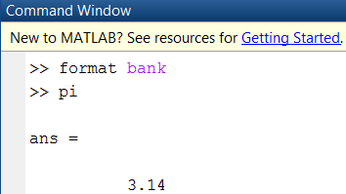
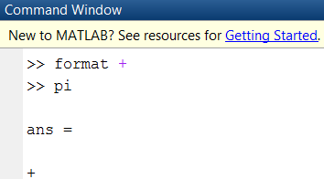
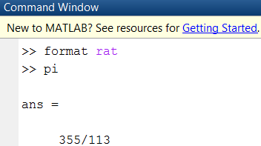
Numeric Display Formats 2
format bank | Two decimal digits; 126.73.
format + | Positive, negative, or zero; +.
format rat | Rational approximation; 43/7.
format compact | Suppresses some blank lines.
format loose | Resets to less compact display mode.

Slide 20
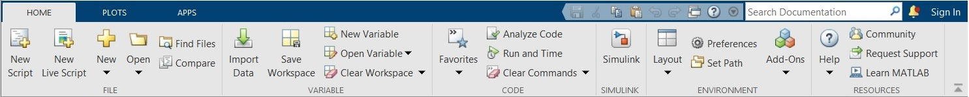
The Toolstrip after Selecting the HOME Tab.
Source: MATLAB

Slide 21
Arrays
The numbers 0, 0.1, 0.2,
, 10 can be assigned to the variable u by
typing u = 0:0.1:10.
To compute w = 5 sin(u) for u = 0, 0.1, 0.2,
, 10, the session is;
>>u = 0:0.1:10;
>>w = 5*sin(u);
The single line, w = 5*sin(u), computed the formula w = 5 sin(u) 101 times.

Slide 22
Array Index
>> u(7)
ans =
0.6000
>>w(7)
ans =
2.8232
Use the length function to determine how many values are in an array.
>>m = length(w)
m =
101

Slide 23
Polynomial Roots
To find the roots of
+ 40x – 34 = 0, the session is
>>a = [1,-7,40,-34];
>>roots(a)
ans =
3.0000 + 5.000i
3.0000 - 5.000i
1.0000
The roots are x = 1 and x = 3 ± 5i.

Slide 24
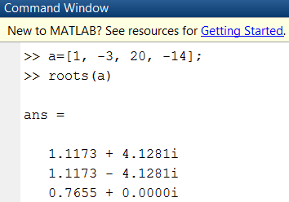
To find the roots of x³ – 3x² + 20x – 14 = 0, the session is
>>a = [1, -3, 20, -14];
>>roots(a)
ans =
1.1173 + 4.1281i
1.1173 – 4.1281i
0.7655
The roots are x = 0.7655 and x = 1.1173 ± 4.1281i.

Slide 25
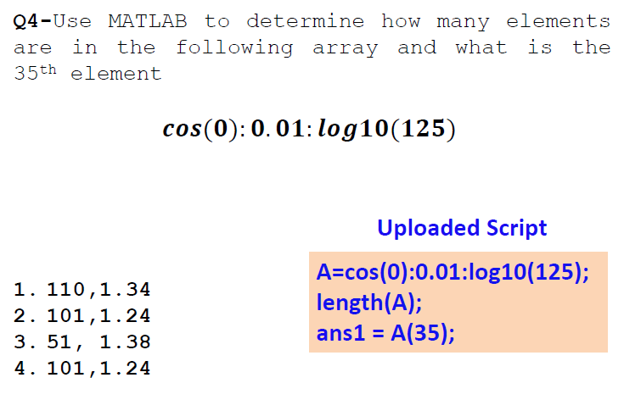

Slide 26
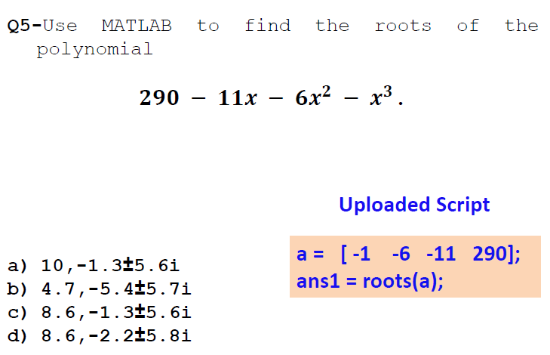

Slide 27
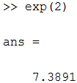
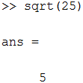
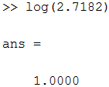
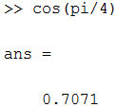
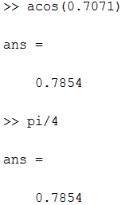
Some Commonly used Mathematical Functions
¹The MATLAB trigonometric functions use radian measure.

Slide 28
Some MATLAB Plotting Commands
Command | Description
[x,y] = ginput(n) | Enables the mouse to get n points from a plot, and returns the x and y coordinates in the vectors x and y.
grid | Puts grid lines on the plot.
gtext(‘text’) | Enables placement of text with the mouse.
plot(x,y) | Generates a plot of the array y versus the array x on rectilinear axes.
xlabel(‘text’) | Adds a text label to the horizontal axis (the abscissa).
ylabel(‘text’) | Adds a text label to the vertical axis (the ordinate).

Slide 29
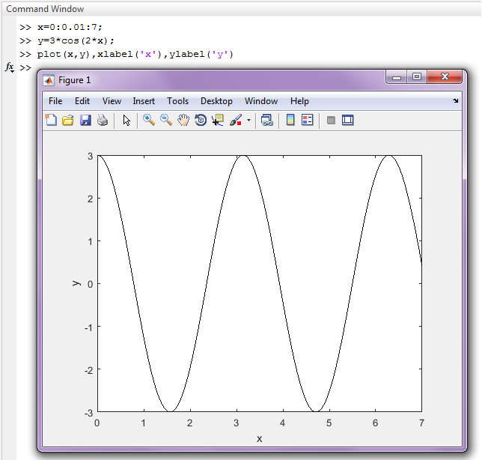
A Figure Window Showing a Plot.
x = 0:0.01:7;
y = 3*cos(2*x);
plot(x,y),xlabel('x'),ylabel('y')
[x,y] = ginput(3)
Access the text alternative for slide images.
Source: MATLAB

Slide 30

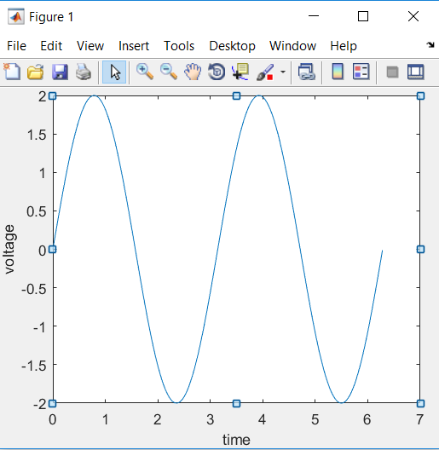
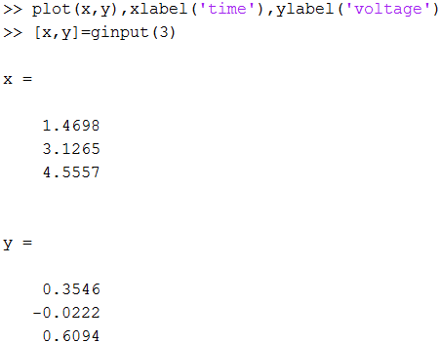

Slide 31
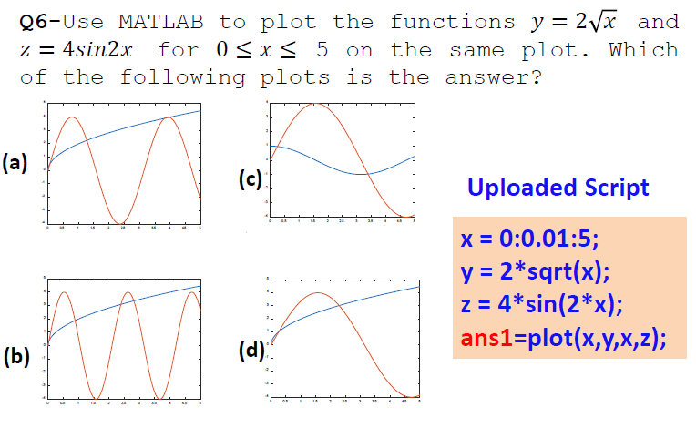

Slide 32
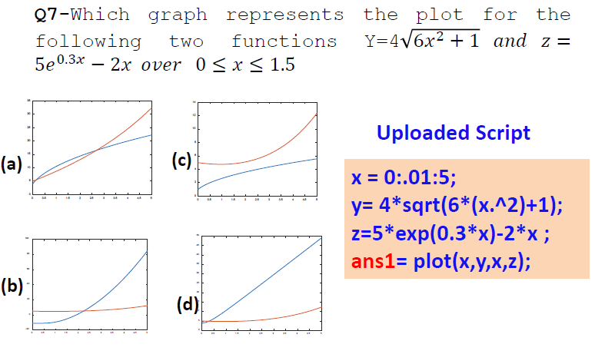

Slide 33
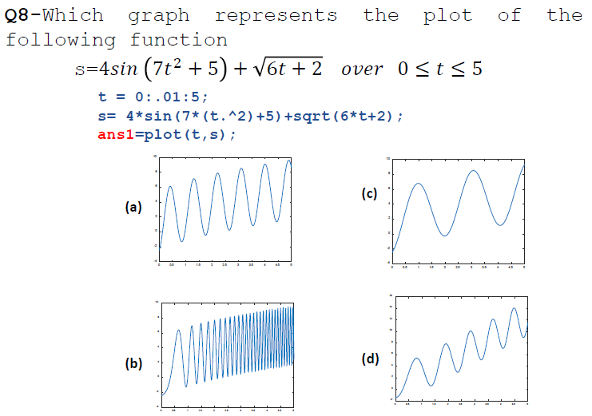

Slide 34
When you type problem1
MATLAB first checks to see if problem1 is a variable and if so, displays its value.
If not, MATLAB then checks to see if problem1 is one of its own commands and executes it if it is.
If not, MATLAB then looks in the current directory for a file named problem1.m and executes problem1 if it finds it.
If not, MATLAB then searches the directories in its search path, in order, for problem1.m and then executes it if found.

Slide 35
System, Directory, and File Commands
cd dirname | Changes the current directory to dirname.
dir | Lists all files in the current directory.
dir dirname | Lists all the files in the directory dirname.
path | Displays the MATLAB search path.
pwd | Displays the current directory.
which item | Displays the path name of item if item is a function or file. Identifies item as a variable if so.

Slide 36
You can perform operations in MATLAB in two ways
In the interactive mode, in which all commands are entered directly in the Command window, or
By running a MATLAB program stored in script file. This type of file contains MATLAB commands, so running it is equivalent to typing all the commands—one at a time—at the Command window prompt. You can run the file by typing its name at the Command window prompt.

Slide 37
Inserting Comments
The comment symbol may be put anywhere in the line. MATLAB ignores everything to the right of the % symbol. For example,
>>% This is a comment.
>>x = 2+3 % So is this.
x =
5
Note that the portion of the line before the % sign is executed to compute x.

Slide 38
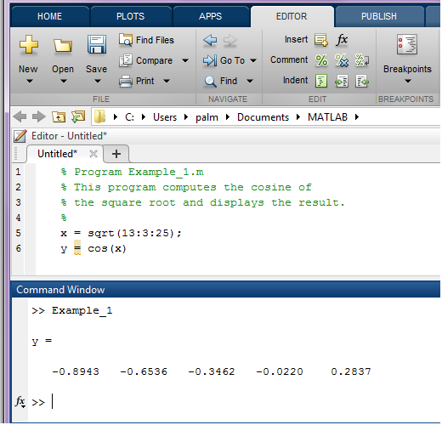
The MATLAB Command Window with the Editor Open.
Source: MATLAB

Slide 39
Keep in mind when using script files
The name of a script file must begin with a letter, and may include digits and the underscore character, and can much longer than you will ever need.
Do not give a script file the same name as a variable.
Do not give a script file the same name as a MATLAB command or function. You can check to see if a command, function or file name already exists by using the exist command.

Slide 40
Debugging Script Files
Program errors usually fall into one of the following categories.
Syntax errors such as omitting a parenthesis or comma, or spelling a command name incorrectly. MATLAB usually detects the more obvious errors and displays a message describing the error and its location.
Errors due to an incorrect mathematical procedure, called runtime errors. Their occurrence often depends on the particular input data. A common example is division by zero.

Slide 41
To locate program errors
Try the following:
Test your program with a simple version of the problem which can be checked by hand.
Display any intermediate calculations by removing semicolons at the end of statements.
Use the debugging features of the Editor/Debugger.

Slide 42
Programming Style 1
Comments section
The name of the program and any key words in the first line.
The date created, and the creators’ names in the second line.
The definitions of the variable names for every input and output variable. Include definitions of variables used in the calculations and units of measurement for all input and all output variables!
The name of every user-defined function called by the program.

Slide 43
Programming Style 2
Input section Include input data and/or the input functions and comments for documentation.
Calculation section
Output section This section might contain functions for displaying the output on the screen.

Slide 44
Some Input/Output Commands
disp(A) | Displays the contents, but not the name, of the array A.
disp(‘abc’) | Displays the text string enclosed within single quotes.
x = input(‘abc’) | Displays the text in quotes, waits for user input from the keyboard, and stores the value in x.
x = input(‘abc’, ‘s’) | Displays the text in quotes, waits for user input from the keyboard, and stores the input as a string in x.

Slide 45
Example of a Script File 1
Problem:
The speed v of a falling object dropped with no initial velocity is given as a function of time t by v = gt.
Plot v as a function of t for 0 < t <
, where
is the
final time entered by the user.

Slide 46
Example of a Script File 2
% Program falling_speed.m:
% Plots speed of a falling object.
% Created on May 5, 2022
% Input Variable:
% tfinal = final time (in seconds)
% Output Variables:
% t = array of times at which speed is
% computed (in seconds)
% v = array of speeds (meters/second)
% Parameter Value:
g = 9.81; % Acceleration in SI units
% Input section:
tfinal = input(’Enter final time in seconds:’);
% Calculation section:
dt = tfinal/500;
% Create an array of 501 time values.
t = 0:dt:tfinal;
% Compute speed values.
v = g*t;
% Output section:
plot(t,v),xlabel(‘t (s)’),ylabel(‘v m/s)’)

Slide 47
Getting Help From the Textbook
Throughout each chapter margin notes identify where key terms are introduced.
Each chapter contains tables summarizing the MATLAB commands introduced in that chapter.
At the end of each chapter is a summary guide to the commands covered in that chapter.
Appendix A contains tables of MATLAB commands, grouped by category, with the appropriate page references.
There are four indexes. The first lists MATLAB commands and symbols, the second lists Simulink blocks, the third lists commands for the Symbolic Math toolbox, and the fourth lists topics.

Slide 48
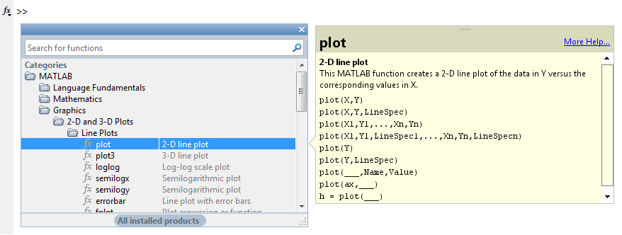
Getting Help From MATLAB: The Function Browser after plot has been selected
Access the text alternative for slide images.
Source: MATLAB

Slide 49
MATLAB Help Functions
help func_name: Displays in the Command window a description of the specified function func_name.
lookfor topic: Displays in the Command window a brief description for all functions whose description includes the specified key word topic.
doc func_name: Opens the Help Browser to the reference page for the specified function func_name, providing a description, additional remarks, and examples.

Slide 50
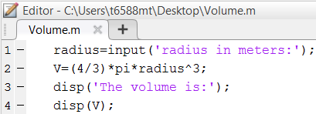
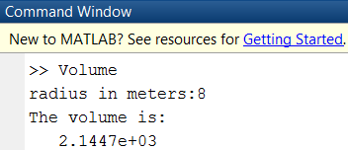
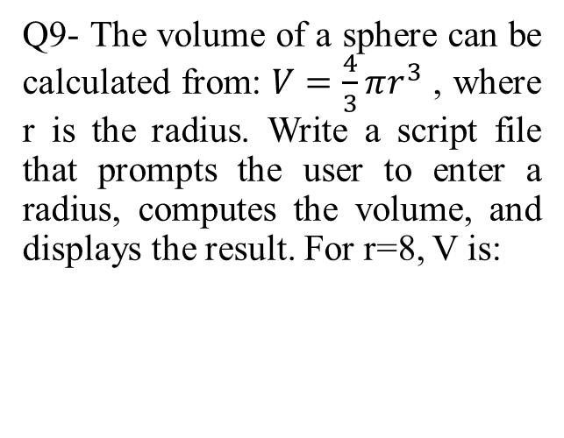
Q9- The volume of a sphere can be calculated from: $V=\frac{4}{3}πr^{3}$ , where r is the radius. Write a script file that prompts the user to enter a radius, computes the volume, and displays the result. For r=8, V is:
3.5e+4
4.8e+2
2.1e+3 (correct)
8.9e+4

Slide 51
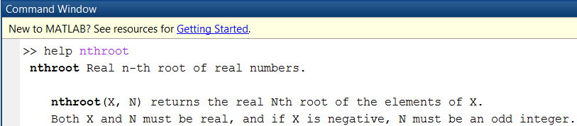
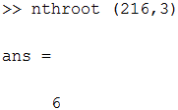

Q10-Use the Help system to learn about the built-in function “nthroot”.
(a) Use “nthroot” to calculate the cube root of 216.
(b) Use “lookfor” to find out how many “nthroot” functions are supported by MATLAB. The answers are:
6 , 2 (correct)
7, 9
4, 5
8, 14

Slide 52
Steps in engineering problem solving 1
Understand the purpose of the problem.
Collect the known information. Realize that some of it might later found to be unnecessary.
Determine what information you must find.
Simplify the problem only enough to obtain the required information. State any assumptions you make.
Draw a sketch and label any necessary variables.
Determine which fundamental principles are applicable.

Slide 53
Steps in engineering problem solving 2
Think generally about your proposed solution approach and consider other approaches before proceeding with the details.
Label each step in the solution process.
If you solve the problem with a program, hand check the results using a simple version of the problem. Checking the dimensions and units and printing the results of intermediate steps in the calculation sequence can uncover mistakes.

Slide 54
Steps in engineering problem solving 3
Perform a “reality check” on your answer. Does it make sense? Estimate the range of the expected result and compare it with your answer. Do not state the answer with greater precision than is justified by any of the following:
(a) The precision of the given information.
(b) The simplifying assumptions.
(c) The requirements of the problem.
Interpret the mathematics. If the mathematics produces multiple answers, do not discard them without considering what they mean. The mathematics might be trying to tell you something, and you might miss an opportunity to discover more about the problem.

Slide 55
Steps for developing a computer solution 1
State the problem concisely.
Specify the input data to be used by the program.
Specify the output information to be generated by the program.
Work through the solution steps by hand or with a calculator; use a simpler set of data if necessary.

Slide 56
Steps for developing a computer solution 2
Write and run the program.
Check the output of the program with your hand solution.
Run the program with your input data and perform a “reality check” on the output. Does it make sense? Estimate the range of the expected result and compare it with your answer.
If you will use the program as a general tool in the future, test it by running it for a range of reasonable data values; perform a reality check on the results.

Slide 57
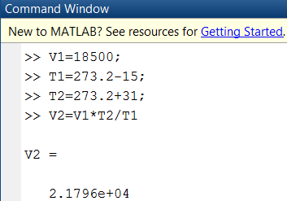
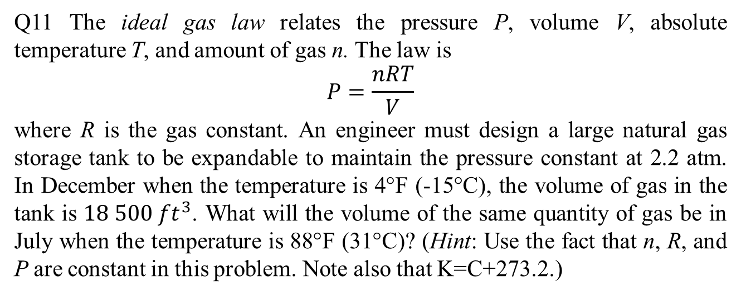
Q11 The ideal gas law relates the pressure P, volume V, absolute temperature T, and amount of gas n. The law is
$$P=\frac{nRT}{V}$$
where R is the gas constant. An engineer must design a large natural gas storage tank to be expandable to maintain the pressure constant at 2.2 atm. In December when the temperature is 4°F (-15°C), the volume of gas in the tank is $18 500 {ft}^{3}$. What will the volume of the same quantity of gas be in July when the temperature is 88°F (31°C)? (Hint: Use the fact that n, R, and P are constant in this problem. Note also that K=C+273.2.)
3.3577e+04
2.1796e+04 (correct)
4.1565e+01
6.2377e+06

Slide 58
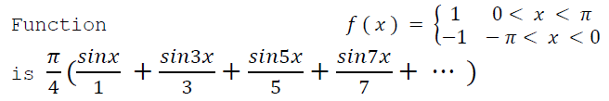

Q12- The Fourier series representation of the
Plot on the same graph, the function f(x) and its series representation, using the four terms shown.
1.5
2
1
1.5
(a)
1
0.5
(c)
0.5
0
0
-0.5
-0.5
-1
-1
-1.5
-1.5
-4
-3
-2
-1
0
x
1
2
3
4
-2
-4
-3
-2
-1
0
x
1
2
3
4
1.5
2
1.5
1
1
(b)
0.5
(d)
0.5
0
0
-0.5
-0.5
-1
-1
-1.5
-1.5
0
x
-2
-4
-3
-2
-1
0
x
1
2
3
4
-4 -3
-2
-1
1
2
3
4

Slide 59
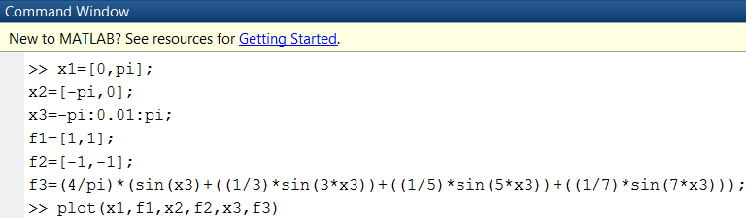
1.5
1
0.5
0
-0.5
-1
-1.5
-4
-3
-2
-1
0
1
2
3
4
x

Slide 60
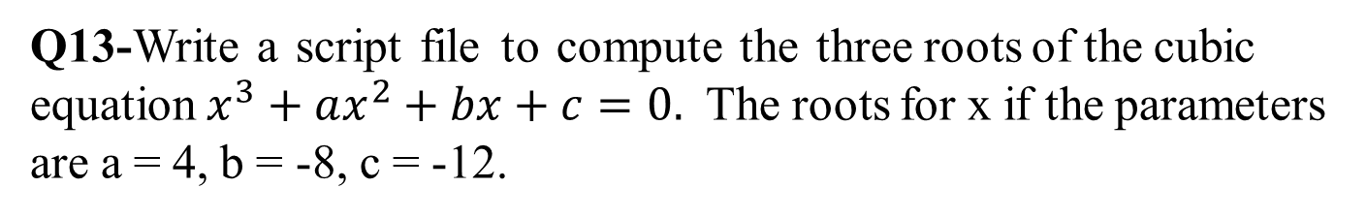
Q13-Write a script file to compute the three roots of the cubic equation $x^{3}+ax^{2}+bx+c=0.$ The roots for x if the parameters are a = 4, b = -8, c = -12.
a) -5.1, 2.1, -1.1
b) -4.2, 1.8, -5.1
c) 1.1, 4.2, -7.7
d) 3.2, -2.2, -2.2
disp('To compute the roots of x^3+ax^2+bx+c=0, enter a, b, and c.') a = input('Enter a: ');
b = input('Enter b: ');
c = input('Enter c: ');
roots([1,a,b,c]);
ans =
-5.1064
2.1830
-1.0765

Slide 61
Q14-Suppose x takes on the values x = 1, 1.2, 1.4, 1.6, … , 5. Use MATLAB to compute the array y that results from the function of y = 4 sin(3x). Find the number of elments in the array y and the value of its third element.
x=1:0.2:6;
y = 4*sin(3*x); ans1=length(y); ans2=y(3);
a) 17, -4.355
b) 14, -3.234
c) 19, -5.237
d) 26, -3.486

Slide 62
End of Main Content
© McGraw Hill LLC. All rights reserved. No reproduction or distribution without the prior written consent of McGraw Hill LLC.

